Slide 1

CSE 464 : Software Quality Assurance and Testing
Equivalent Partitions – Lecture 2
Janaka Balasooriya

Slide 2
EP : The Triangle Problem Example

Slide 3
Triangle Problem
Triangle program accepts three integers a, b, and c as inputs. These are taken to be sides of a triangle. The output of the program is the type of triangle determined by the three sides: Equilateral, Isosceles, Scalene, or Not A Triangle. In addition 1 <= a <= 200, 1 <= b <= 200, and 1 <= c <= 200.
Also, to be a triangle sum of any two sides should be greater than the other side ( a < b +c , c < a + b, b < a +c ).

Slide 4
Triangle Problem Equivalent Partitioning : Approach 1
Consider inputs: a , b, and c for equivalent partitions

Slide 5
Triangle Problem Equivalent Partitioning : Approach 2
Consider outputs for equivalent partitions

Slide 6
Triangle Problem Equivalent Partitioning : Approach 2 … cont.
Again, we can try to generate EPs based on output. In addition, we can try to classify them based on weak and strong using the classification stated in the book.
Four possible outcomes
Equilateral
E1 = {<a, b, c> : the triangle with sides a, b, and c where a=b=c}
Isosceles
E2 = {<a, b, c> : the triangle with sides a, b, and c where a=b, a≠c | b=c, b≠a | a=c , a≠b}
Scalene
E3 = {<a, b, c> : the triangle with sides a, b, and c where a≠b≠c }
Not A Triangle
E4 = {<a, b, c> : the triangle with sides a, b, and c where a + b <= c | a + c <= b | b + c <= a }

Slide 7
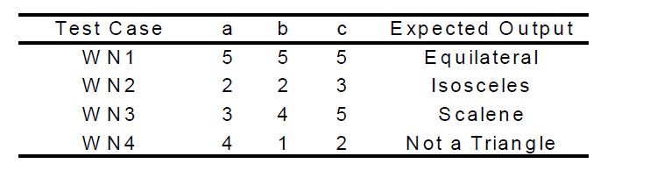
Triangle Problem Equivalent Partitioning : Approach 2 …cont.
Weak Normal:
Strong Normal :
Since a, b, c do not have valid subintervals, Strong normal test cases are same as weak normal

Slide 8
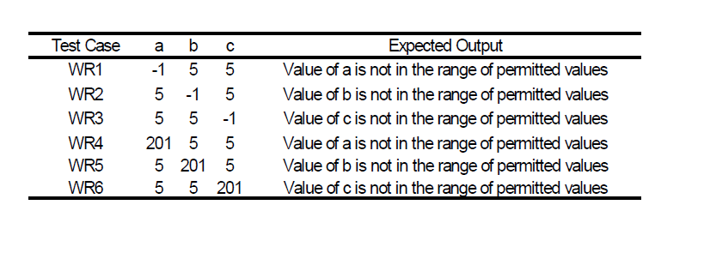
Triangle Problem Equivalent Partitioning : Approach 2 … cont
Weak Robust: considering invalid values for a, b, and c we get following additional test cases.
Strong Robust : In addition to weak robust test cases, we can consider multiple fault assumption for invalid inputs for a, b, and c

Slide 9
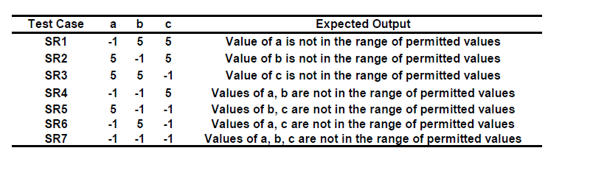
Triangle Problem Equivalent Partitioning : Approach 2 …cont
Strong Robust : In addition to weak robust test cases, we can consider multiple fault assumption for invalid inputs for a, b, and c

Slide 10
Triangle Problem : Test case automation using Eclipse and Junit – Demo during the class
http://junit.sourceforge.net/javadoc/org/junit/Assert.html

Slide 11
EP : NextDay Function
In-class

Slide 12
Equivalent Class Testing Does Not Cover…..
Many faults can happen around upper and lower limits of variable data values. For example, loop conditions (< instead of ≤), counters
Equivalent partitioning does not specifically address them.
So, to uncover faults around boundaries of equivalent classes => Boundary Values Analysis

Slide 13
Boundary Value Analysis
Chapter 5

Slide 14
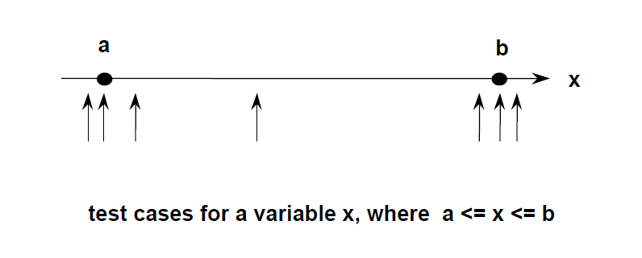
What is Boundary Value Analysis?
Method
• Hold all variables at their nominal value.
• Let one variable assume its boundary values.
• Repeat this for each variable.
• This will (hopefully) reveal all faults that can be attributed to a single variable.
Boundary value analysis works well when the program to be tested is a function of several independent variables that represent bounded physical quantities

